Slide 1
Today’s Science Applied to Yesterday’s Facts: Mitigation Investigation in Juvenile Post-Conviction Cases
Lone Star Justice Alliance
Emily Schuerman

Slide 2
What is Mitigation?
Investigation
Rapport-building
Exhaustive Research
Teamwork
Supporting the client
Creating a narrative that introduces the client for who they are, not what they’ve done.
Notes:
So what is mitigation? You may have heard the term before paired with the word “circumstances” i.e. mitigating circumstances, and it is definitely related to that. All people are shaped by events that happen to them throughout their life. Often times the events that occur in our lives can precede our actions later on. Mitigation involves investigating what circumstances could have preceded a client’s actions in the crime for which they are charged, and developing a narrative that does not excuse the crime, but provides an explanation for it. Mitigation includes all of the items on this slide, but most importantly: seeks to develop a narrative that shows who the client is beyond the crime.

Slide 3
Mitigation: the process of humanizing a petitioner through fact-based storytelling.

Slide 4

How do we develop mitigation for our clients?
Notes:
So how do we develop proper mitigation for our clients?

Slide 5
Mitigation: Past, Present, Future
Past – social history investigation
Present – accomplishments during detention; programs completed, expressions of remorse, evidence of rehabilitation
Future – Planning to come home
Notes:
In 2012 the supreme court ruled in Miller v. Alabama that mandatory LWOP for juvenile offenders was unconstitutional and a violation of the juvenile’s 8th amendment rights against cruel and unusual punishment. This ruling was applied retroactively in 2016 when the supreme court heard Montgomery v Louisiana. This created a situation in which many incarcerated folks who had been sentenced to LWOP as juveniles were now up for resentencing. One of the main reasons for this change in our legal system is the continued growth of knowledge in the realm of neuroscience and psychology. We now know that brain development (specifically the prefrontal cortex..the decision making center of the brain) is not fully developed until around age 25. Therefore, there is no reason that teenagers should be treated or expected to act the same was as adults over age 25.

Slide 6
Components of Mitigation
A
B
C
Interviews
Collecting Records
Creating lists of people or places
D
E
F
Chronology/ Timeline of events
Theory Memorandum
Social History
Notes:
Interviews, gathering documents, creating lists of people or places, developing a timeline the client’s life, developing theories supported by evidence found in the documents, and creating a social history that paints a picture of the client’s life story. It is also important to note that mitigation in juvenile lifer cases requires a reentry plan for when the client is paroled.

Slide 7
Interviews
Client
All available family (parents, guardians, siblings, aunts/uncles, grandparents, cousins, godparents)
Client’s children
Friends
Significant others
School teachers, counselors, principals (and then some...)
Correctional officers
Mental health providers/therapist/psychologist
Coaches
Ministers, rabbis, imams
Role models
Employers
Co-workers
Fellow inmates
Community leaders
Foster parents

Slide 8
Collecting Records
School records
Hospital/Medical Provider records
Mental health records
Social service records (DHS, food stamps, WIC, AFCD, welfare, SS, foster homes, etc)
Juvenile court/institutional records
Probation/parole records
Employment records
Family photographs/home videos
Pictures of the home environment/video
Diplomas, school awards/achievements
Correspondence between client and family (especially children!)
Artwork, poetry, prose by client

Slide 9
Understanding Context
Transmit findings from interviews and records to experts to assist in preparing psychological reports, social histories, and establishing admission eligibility for community placements

Slide 10
Motivational Interviewing
Motivational Interviewing is a directive, client-centered counseling style for eliciting behavior change by helping clients explore and resolve ambivalence.
Traditional Interviewing
Invoke information (plea, persuade
Logical persuasion
Tell what to do
Tell why to do it
Motivational Interviewing
Evoke information (draw-out)
Support positive talk
Ask open-ended questions
Encourage reflection

Slide 11
Ethical Considerations in Legal Practice
We don’t want to guide the witness
  Be careful not to put words in the client’s mouth
Let the client tell their story
  Be affirming
  Ask Furthering Questions
ABA Guidelines:
  “Lawyers generally may not ask leading questions of their own witnesses. Leading questions are questions that suggest the answers desired, in effect prompting the witness”

Slide 12
Motivational Interviewing Strategies
Active Listening
  Reflecting, Summarizing, Furthering
Be Affirming and Accepting, Express Empathy
Ask open-ended questions about the client’s concerns, feelings, plans, and be affirming with responses
Selectively reinforce the client’s own self-motivational statements
Use body-language that shows you are engaged and fully listening to the client’s story

Slide 13
Legal Overview
Notes:
So, how does this apply to the JSP?

Slide 14
-Justice Anthony m. Kennedy,
Montgomery v. Louisiana (2016)
“Children who commit even heinous crimes are capable of change.”

Slide 15
Miller & Montgomery Mitigation
Mitigation is a constitutional safeguard required by the supreme court after Miller v. Alabama and Montgomery v. Louisiana.
The supreme court ruled mandatory LWOP for juveniles unconstitutional (Miller v. Alabama). As this applies retroactively (Montgomery v. Louisiana), there are many individuals who are eligible for resentencing.
Neuroscience
  Adolescent brains are continually developing until around age 25
  Decision-making may be hindered in teen years
Notes:
In 2012 the supreme court ruled in Miller v. Alabama that mandatory LWOP for juvenile offenders was unconstitutional and a violation of the juvenile’s 8th amendment rights against cruel and unusual punishment. This ruling was applied retroactively in 2016 when the supreme court heard Montgomery v Louisiana. This created a situation in which many incarcerated folks who had been sentenced to LWOP as juveniles were now up for resentencing. One of the main reasons for this change in our legal system is the continued growth of knowledge in the realm of neuroscience and psychology. We now know that brain development (specifically the prefrontal cortex..the decision making center of the brain) is not fully developed until around age 25. Therefore, there is no reason that teenagers should be treated or expected to act the same was as adults over age 25.

Slide 16
Miller, Montgomery & Mitigation
The flaws of mandatory LWOP
  Ignores chronological age/maturity
  Ignores systems: home, school, peers
  Ignores abuse/neglect history and correlation
  Ignores extent of the juvenile’s participation in the offense
  Ignores legal incompetencies of the juvenile
Notes:
There are many flaws to mandatory LWOP for juveniles. Due to the nature of the developing brain, juveniles are unable to make well thought decisions about their future. Mandatory LWOP also ignores any and all systemic influences in the life of a juvenile. For example, home life, school life, and peer relationships. Mandatory LWOP also ignores any history of abuse, neglect, or trauma experienced by the Juvenile. It also ignores the extent of participation in the offense, as well as the juvenile’s incompetencies with the various obstacles of our legal system.

Slide 17
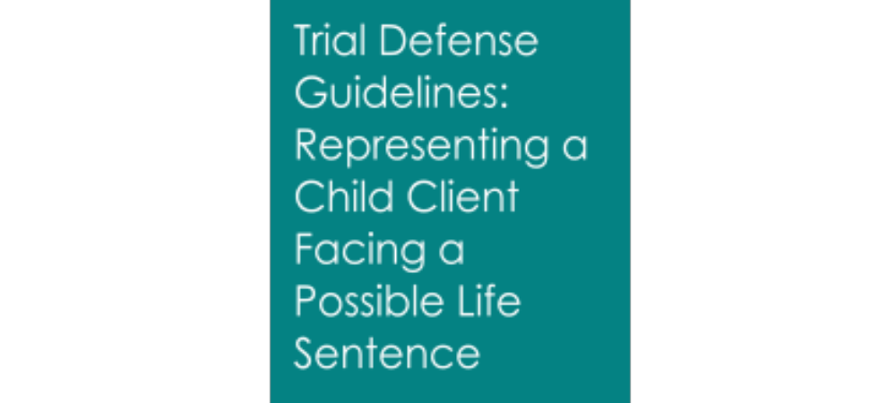
Best Practices for Defense Counsel
The representation of children in adult court facing a possible life sentence is a highly specialized area of legal practice, therefore these guidelines address the unique considerations specific to the provision of a zealous trial defense.

Slide 18
Guidelines
The Defense Team must include a minimum of two qualified attorneys, an investigator, a mitigation specialist, and, when appropriate, an interpreter.
        Specialized training representing child clients and individuals charged with homicide offenses.
        Thorough investigation, including investigation of mitigating factors.
        Refer to scope of investigation outlined in key death penalty cases: Wiggins v. Smith and Rompilla v. Beard.

Slide 19
Mitigating Evidence Based on Miller Factors

Slide 20
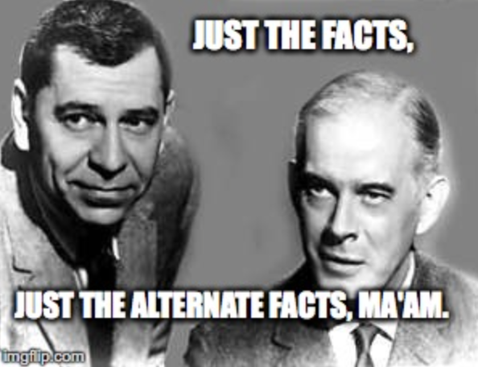
Review the case through today’s science

Slide 21
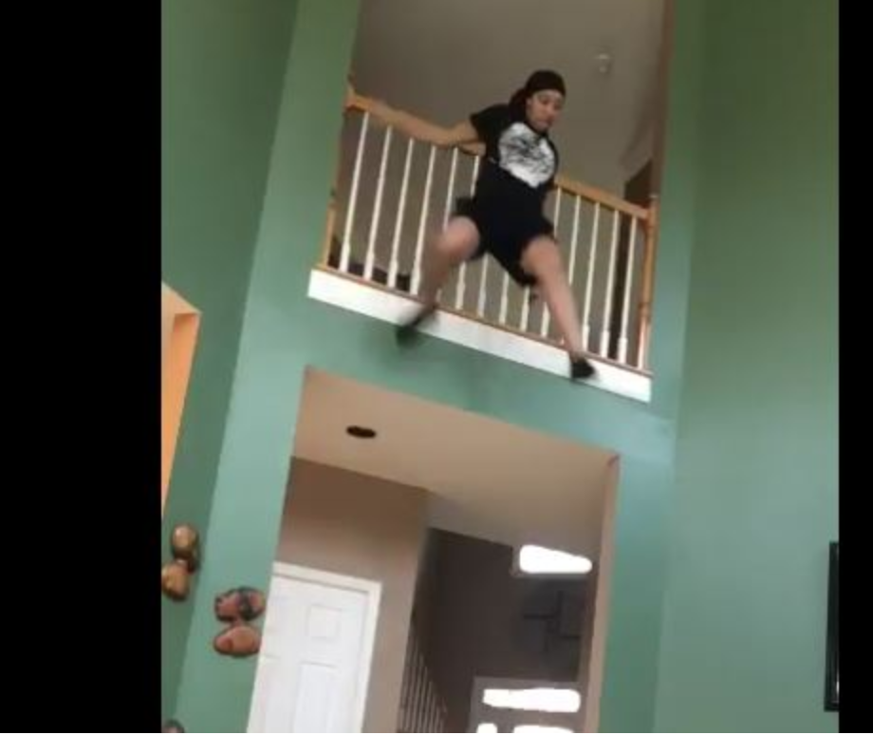
Distinguishing Between
Adults and Juveniles
First, children have a lack of maturity and an underdeveloped sense of responsibility, leading to recklessness, impulsivity, and heedless risk-taking.
Notes:
Roper: First, as any parent knows and as the scientific and sociological studies respondent and his amici tend to confirm, "[a] lack of maturity and an underdeveloped sense of responsibility are found in youth more often than in adults and are more understandable among the young. These qualities often result in impetuous and ill-considered actions and decisions.

Slide 22
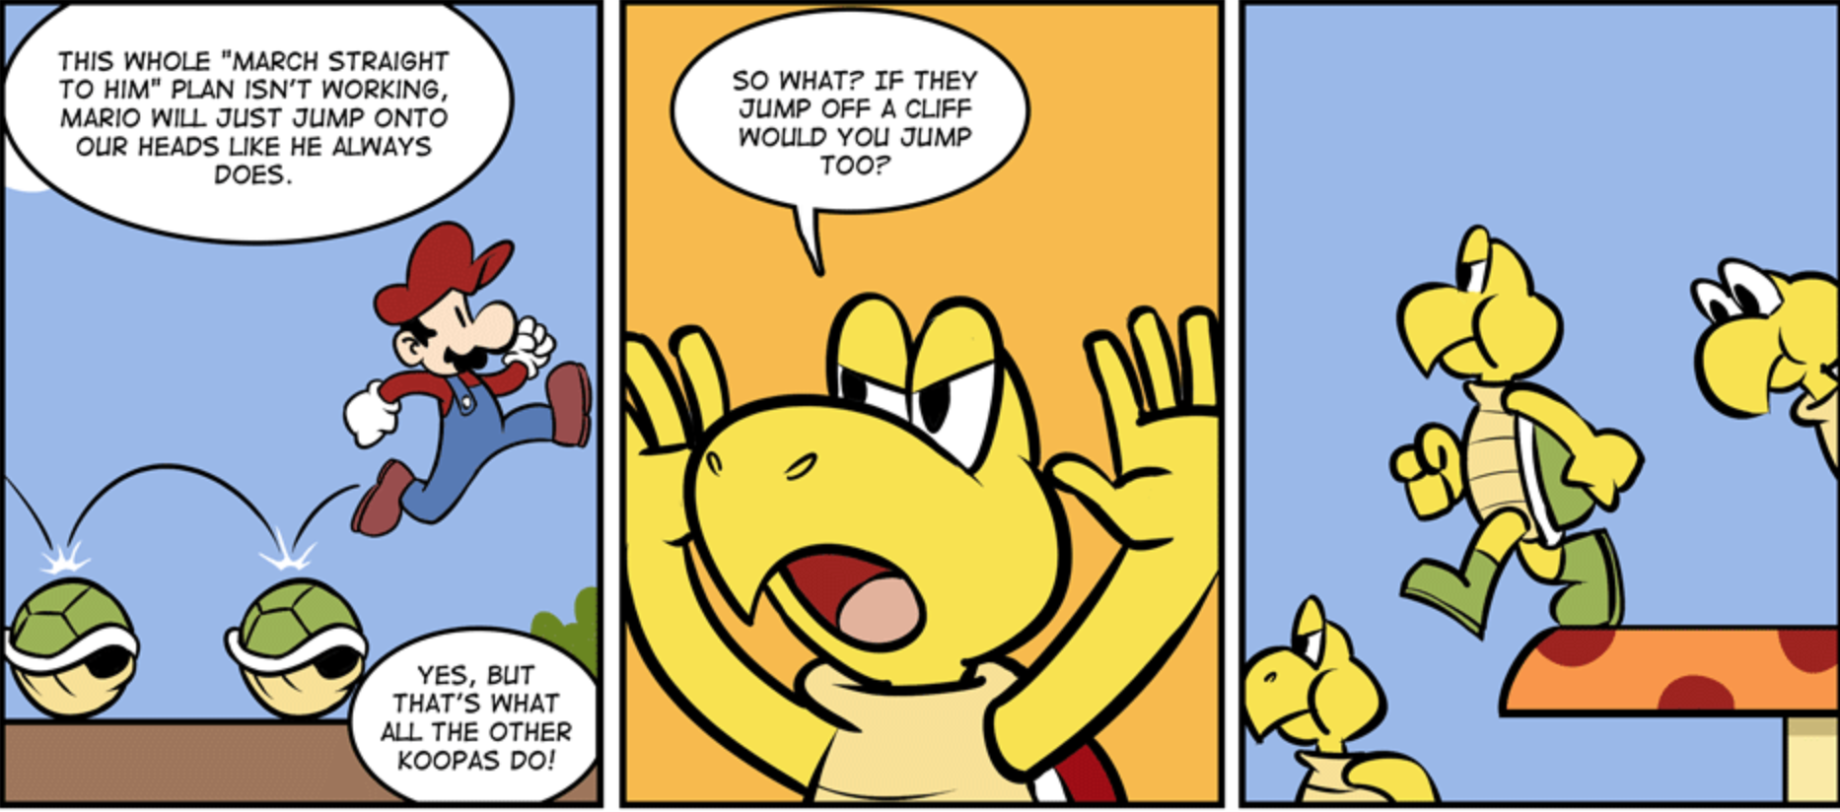
Distinguishing Between
Adults and Juveniles
Second, the Supreme Court recognized that youth are distinct from adults in constitutionally relevant ways because of their susceptibility to outside pressures.
Notes:
Roper: The second area of difference is that juveniles are more vulnerable or susceptible to negative influences and outside pressures, including peer pressure.

Slide 23
Increased Capacity for Rehabilitation
Roper: The third broad difference is that the character of a juvenile is not as well formed as that of an adult.
The personality traits of juveniles are more transitory, less fixed.
Notes:
Roper: The third broad difference is that the character of a juvenile is not as well formed as that of an adult. The personality traits of juveniles are more transitory, less fixed.

Slide 24

Risky Behavior: Momentary Impulse Not Deviance
Elements of the charged offense(s), including the element(s) alleged
Whether he was charged as the primary shooter/killer or whether he was convicted under the felony murder rule or as an aider and abettor
How the judge viewed your client’s case during his sentencing, specifically which facts the judge knew about and considered and which facts the judge did not know about when s/he sentenced your client to LWOP
Whether any of your client’s co-defendants or other participants in the crime were adults (over the age of 18)

Slide 25
Emotional And Mental Health
Any Mental Health problems
Learning problems/ disabilities
Hospitalizations
Counseling/ Failure to be given Counseling
Physical illness or injuries
Alcohol or drug abuse
Prenatal and birth trauma
Malnutrition
Developmental delays
Brain damage/head injuries
Exposure to violence in home or neighborhood

Slide 26


Gang Affiliation
Friends from the Neighborhood

Slide 27
Family/Home Environment
Abuse: physical, sexual, emotional
Poverty, homelessness
Family history of mental illness, substance use, domestic violence
Peer influence
Neighborhood safety, gang involvement
Other trauma: exposure to violence, loss of loved one, natural disaster
Neglect/Abandonment
Experience in foster care
Experiences of racism/ other systemic biases
Cultural/ religious influences
Failure of the government, school, or other systems to help the child

Slide 28
Education
Grades prior to arrest?
Held back a grade?
Tested for learning disabilities?
Behavioral problems?
Special education needs (Did they have an IEP or “student study team”?)
Were they referred for special needs testing? Did they get services?

Slide 29
Rehabilitation
His prior juvenile and adult system experience
Programs he was in or services he received prior to the crime and how responsive he was to those services
What he is doing currently, including programming; dropping out of gangs; changed ways of thinking; books read; religious practices; helping or mentoring others around him; sobriety or services
Whether he feels remorse, regret, or sadness about his role in the crime and what happened to the victim, his or her family and the community
You may also want to CAREFULLY consider whether your client should express remorse to members of the victim’s family– to help them understand his actions and heal from their loss

Slide 30
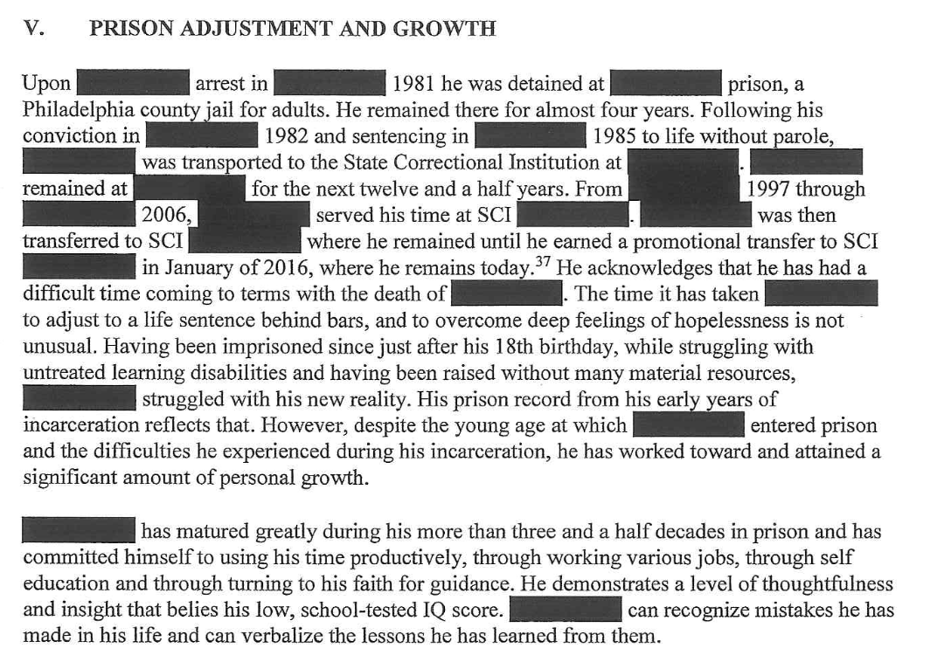
Capacity for Rehabilitation: What’s happening now?

Slide 31
Possibility for Rehabilitation
Their prior juvenile and adult system experience
Programs/ services they received prior to the crime and how responsive they were to those
What they are doing currently: programming; dropping out of gangs; changed thinking; books read; religious practices; mentoring others around them; sobriety
115s or 128s he may have
Whether they feels remorse about their role in the crime
You may also want to CAREFULLY consider whether your client should express remorse to the victim’s family – through the CDCR’s victim services

Slide 32
—Bryan Stevenson
“
“Most Parents have long understood that kids don’t have the judgement, the maturity, the impulse control, and insight necessary to make complicated life-long decisions”
Notes:
Closing with this quote from Bryan Stevenson (awesome lawyer!)

Slide 33
Jones v. Mississippi, 141 S.Ct. 1307 (2021)
The Court declined to extend Miller to require an additional finding of fact as to the defendant’s incorrigibility, holding that it only required that the sentencer have discretion to consider the defendant’s youthfulness before assigning a LWOP sentence.

Slide 34
Jones v. Mississippi, 141 S.Ct. 1307 (2021)
The Court’s decision does not preclude the States from imposing additional sentencing limits in cases involving murderers under 18.

Slide 35
States may categorically prohibit life without parole for all offenders under 18.
Or States may require sentencers to make extra factual findings before sentencing an offender under 18 to life without parole.
Or States may direct sentencers to formally explain on the record why a life-without-parole sentence is appropriate notwithstanding the defendant's youth.
States may also establish rigorous proportionality or other substantive appellate review of life-without-parole sentences.
All of those options, and others, remain available to the States.

Slide 36


