Slide 1
Motivational Interviewing
Lone Star Justice Alliance
Training Product

Slide 2
Motivational Interviewing is a directive, client-centered counseling style for eliciting behavior change by helping clients explore and resolve ambivalence.

Slide 3

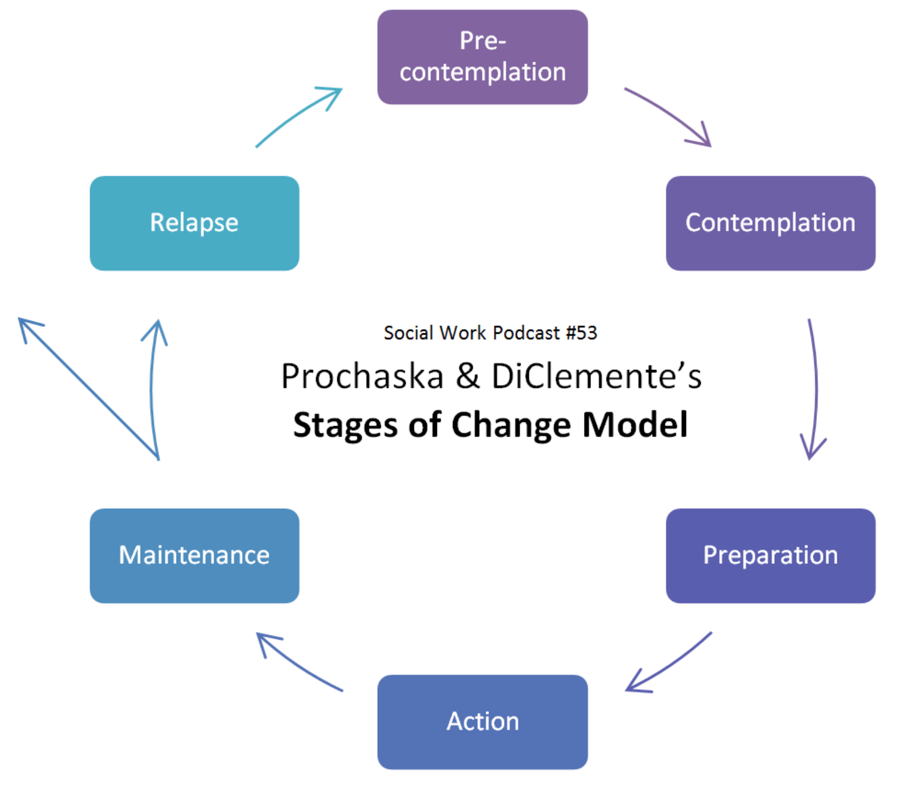
Stages of Change

Slide 4

Start Where The Client Is

Slide 5
How is Motivational Interviewing Different?
Traditionally
Motivational Interviewing
Invoke information (plea, persuade)​
Logical persuasion​
Tell what to do​
Tell why to do it​
Evoke information (draw-out)​
Support Positive-Talk​
Open-Ended Questions
Reflections

Slide 6
Ethical Considerations in Legal Practice
We don’t want to guide the witness
  Be careful not to put words in the client’s mouth
Let the client tell their story
  Be affirming
  Ask Furthering Questions
ABA Guidelines:
  “Lawyers generally may not ask leading questions of their own witnesses. Leading questions are questions that suggest the answers desired, in effect prompting the witness”

Slide 7
Motivational Interviewing Strategies
Active Listening
  Reflecting, Summarizing, Furthering
Be Affirming and Accepting, Express Empathy
Ask open-ended questions about the client’s concerns, feelings, plans, and be affirming with responses
Selectively reinforce the client’s own self-motivational statements
Use body-language that shows you are engaged and fully listening to the client’s story

Slide 8
—William R. Miller, Motivational Interviewing: Helping People Change
“Motivational interviewing is a collaborative conversation style for strengthening a person’s own motivation and commitment to change.”

Slide 9
Questions

Slide 10
References
Miller, W. R., &amp; Rollnick, S. (2012). Motivational Interviewing: Helping
People Change. New York: Guilford Publ.
Steiker, L. H. (2016). Youth and substance use: Prevention, intervention,
and recovery. Chicago, IL: Lyceum Books.
ABA Motivational Interviewing:
https://www.americanbar.org/groups/public_interest/child_law/resources/child_law_practiceonline/child_law_practice/vol-36/may-june-2017/motivational-interviewing--counseling-clients-in-challenging-con/
ABA Leading Witnesses (How Courts Work):
https://www.americanbar.org/groups/public_education/resources/law_related_education_network/how_courts_work/directexam/#:~:text=The%20questions%20they%20ask%20of,both%20direct%20and%20circumstantial%20evidence.&text=Lawyers%20generally%20may%20not%20ask,in%20effect%20prompting%20the%20witness.
https://socialworkpodcast.blogspot.com/2009/10/prochaska-and-diclementes-stages-of.html

