Slide 1


Juvenile Record Sealing
Notes:
Regardless of whether the child ’s conduct was adjudicated, the child has a juvenile record with the Department of Public Safety and the Federal Bureau of Investigation and the child’s juvenile record is a permanent record unless the record is sealed.
Individuals must report these offenses when asked about criminal history on employment applications.
Tex. Fam. Code, 58.262 (c) (1)(2) (2017).

Slide 2
When do records begin?
Police Records
Juvenile Record
Begins as soon as holding
No charges necessary
Begins at Detainment
Notes:
As an advocate, you must follow up and make sure that the records are sealed or destroyed

Slide 3
Where are Juvenile Records stored?
Each juvenile record is held by at least 5 agencies:
County Clerk
County Attorney’s Office
Texas Department of Public Safety
Arresting agency
Schools and school districts
DFPS if child is involved in foster care case

Slide 4

Do Juvenile Records automatically go away?

Slide 5
In a word, No.
Access to juvenile records is not public; however, many entities can access– state agencies, federal agencies, law enforcement, prosecutors, colleges, financial aid and anyone with a “legitimate interest” in matter.
Recent legislation attempted to create a protocol for “automatic sealing” of many juvenile records when someone turns 19 BUT, there are big implementation problems: PROCESS
Currently no reliable guarantee or timeline for automatic sealing
Many kids need to have these records sealed before they are 19 so they don’t have issues with employment, college applications, financial, military, etc.
Best practice is to petition juvenile court for sealing of records

Slide 6

Types of disposition
NON-ADJUDICATION | DEFERRED PROSECUTION | First time referrals for Misd. POM, Misd. Theft or CINS = “Conduct Indicating Need for Supervision” No charge filed, no court appearance Special 90- or 180-day supervision program
 | DEFERRED ADJUDICATION | Can be offered for misdemeanors or felonies Charge filed; no adjudication if terms of supervision successfully completed Non-suit entered upon successful completion
 | NON-SUIT | “Dismissal” of the cause by prosecutor
ADJUDICATION | FORMAL ADJUDICATION | Either juvenile pleads “true” to engaging in delinquent conduct, or Juvenile pleads “not true” and is found to have engaged in delinquent conduct after either a jury or bench trial Typical punishment assessed is community supervision
 | DETERMINATE SENTENCE | Special prosecution designation for serious felonies Effect is that juvenile can be sentenced to term of confinement exceeding court’s jurisdiction (i.e., past age 17)
Certification as Adult; Juvenile is Prosecuted in Criminal Court

Slide 7

Which of these dispositions creates a record?

Slide 8
Eligibility for sealing by application
Age 17 or older OR; 1 years+ since end of case
Both felonies and misdemeanors are eligible for sealing
No determinate sentences*
No adjudication of habitual felony conduct*
No current requirement to register as a sex offender*
No adult felony convictions
No pending juvenile or adult matters
Tex. Fam. Code §§ 58.251-265*

Slide 9

Cases ineligible for sealing
Determinate Sentences
Tex. Fam. Code § 53.045
Engaging in Habitual Felony Conduct
Tex. Fam. Code § 51.031

Slide 10



Effect of sealing records
Notes:
After 61 days, upon inquiry, agencies must respond that no such records exist
Once a person’s record is sealed, he or she is not required to state in any proceeding or in any application for employment, licensing, admission, housing, or other public or private benefit that the person has been the subject of a juvenile matter.
Individual can legally deny any previous involvement with any juvenile or criminal proceeding and go forward as if the offense never occurred.

Slide 11
Effect of sealing records (cont’d)
If a person's records have been sealed, the information in the records, the fact that the records once existed, or the person's denial of the existence of the records or of the person's involvement in a juvenile matter may not be used against the person in any manner, including in:
(1) a perjury prosecution or other criminal proceeding;
(2) a civil proceeding, including an administrative proceeding involving a governmental entity;
(3) an application process for licensing or certification; or
(4) an admission, employment, or housing decision.
A person who is the subject of the sealed records may not waive the protected status of the records or the consequences of the protected status.
How we know it works: DA, military, clients

Slide 12
JUVENILE RECORDS SEALING
Procedure overview
Schedule
Schedule client meeting
Draft
Application
Hold
Hold client meeting (pro bono legal agreement; client interview; explanation of sealing process, expectations, and legal effect of sealing)
File
File pleadings
Attend
Attend hearing (if ordered)
Send
Send closing letter and copy of order to client
Secure
Secure client agreement

Slide 13
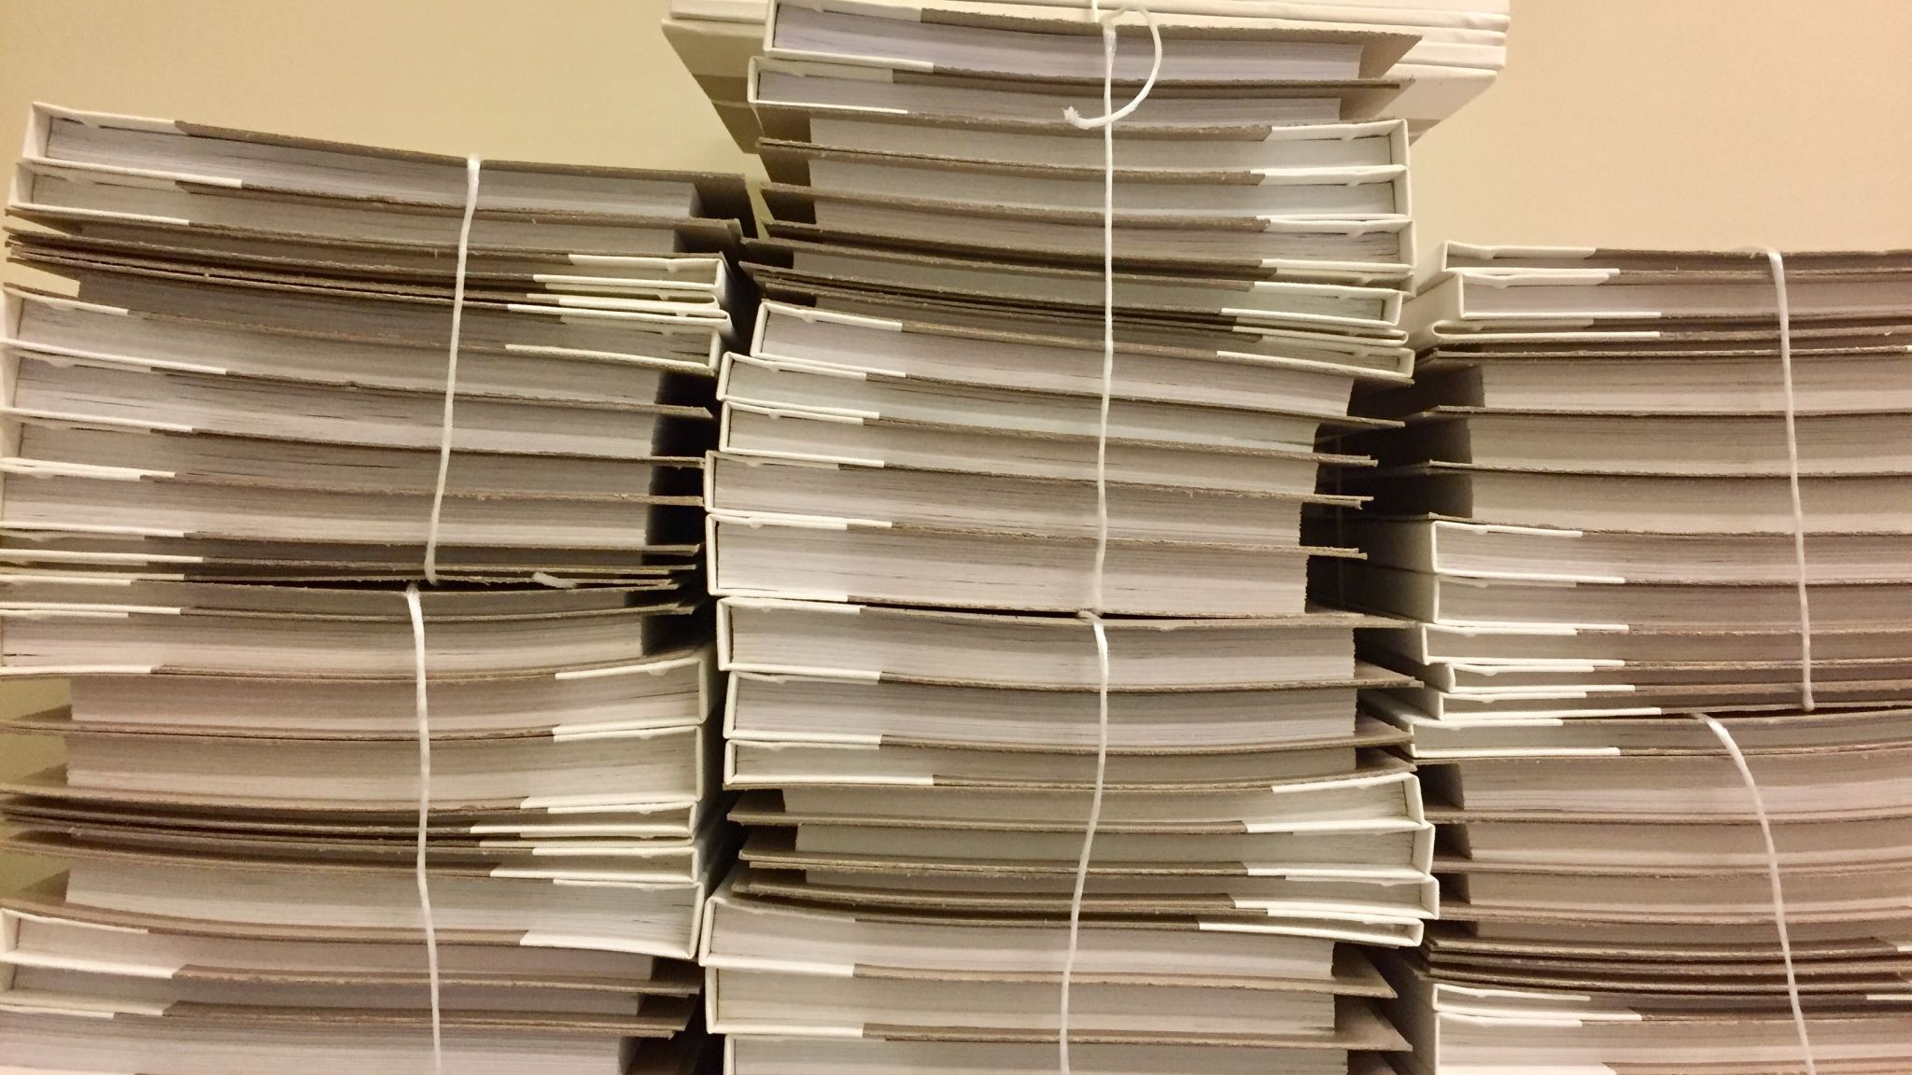
Consequences of Unsealed Records

Slide 14
How will a juvenile record affect education?

Slide 15

Primary and Secondary Education
Law enforcement must inform schools if a child was arrested for any felonies and some misdemeanors including:
  Possession of unlawful weapons
  Possession of a controlled substance
  Assault, unlawful restraint, or deadly conduct
  Indecent exposure
  Terroristic threats
  Tex. Crim. Proc. Code Ann. § 15.27

Slide 16
Primary and Secondary Education
Principals can notify teachers
Schools can remove children from their regular classes and place them in an alternative program if the child was found guilty of a felony, received a deferred prosecution for a felony, or the principal thinks that the child committed a felony
Tex. Crim. Proc. Code Ann. § 15.27
Notes:
The consequences of reporting to schools can be grave
These consequences are multi-faceted, affecting the child’s social, emotional, psychological, and educational future.

Slide 17

College and Trade Schools
“Convicted” versus “Adjudicated”
Common App
  Banned the Box in 2019!
Independent Background Checks

Slide 18
College and Trade Schools
Student Loans/FAFSA
  A juvenile adjudication does NOT affect a student’s ability to receive a loan.
  FAFSA only asks about drug-related convictions that occurred while receiving federal student loans

Slide 19
How will a juvenile record affect employment?

Slide 20

Employment
  A delinquency adjudication can stop someone from becoming any number of registered, licensed, or certified professions including:
    Nursing/Dental
    Teaching
    Securities/Accounting
    Law
    Electricians
    Home Health Care/Child Care
Notes:
Delinquency can demonstrate “poor character” on applications for licenses and certifications

Slide 21
Employment
  A delinquency adjudication can also stop someone from working in law enforcement, probation, or even mentor positions.

Slide 22

Military
  A delinquency adjudication can hurt one’s chances of joining the military
    This is true even when the case has been sealed or expunged!

Slide 23
Military
  The military may ask to see copies of important documents related to the adjudication
  As an advocate, make sure you explain this to your client and obtain copies of the adjudication before the record is sealed if your client may be interested in joining

Slide 24
How will a juvenile record affect Public Benefits?

Slide 25

Public Benefits
Housing
  Families can be evicted from Section 8 housing if a family member does drugs or commits a violent act – even if there is no adjudicatory hearing
  Dispositions that include registering as a sex offender greatly and adversely affect public housing
Notes:
24 C.F.R. § 966.4(1)(5)(I)(B)
24 C.F.R. § 966.4(1)(5)(III)

Slide 26
Public Benefits
Medicaid
  Medicaid benefits are suspended during any detention period
Supplemental Security Income (SSI)
  Parents and guardians might not be able to receive SSI while the child is detained
Notes:
24 C.F.R. § 966.4(1)(5)(I)(B)
24 C.F.R. § 966.4(1)(5)(III)

Slide 27
How will a juvenile record affect immigration?

Slide 28

Immigration
Legal Status
  Certain offenses make progress through legal status channels more difficult
    Drug Trafficking
    Drug abuse or addiction
    Violation of a Protection Order
    Prostitution
    Sexual Assault
Undocumented Status
  Even a simple arrest can cause significant issues
Notes:
8 U.S.C. § 1227(a)(2)
8 U.S.C. § 1182(A)

Slide 29
Immigration
Mitigating circumstances can provide “Special Immigrant Juvenile Status” (SIJS)
  Abuse, neglect abandonment
  Human trafficking
  Sex trafficking
  Victim of a crime
See the Immigrant Legal Resource Center’s website: www.ilrc.org
Notes:
8 U.S.C. § 1227(a)(2)
8 U.S.C. § 1182(A)

Slide 30
How will a juvenile record affect the sex offender registry?

Slide 31
Registered Sex Offender
Most minors who are required to register must do so until the 10th anniversary of their final disposition, or 10 years after they complete the terms of their disposition, whichever date is later.
Juvenile sex offenders who must register because their case was transferred to the adult system must register until 10 years after the date on which they were discharged from state supervision through probation or parole, or 10 years from the date that they completed the terms of the disposition, whichever is later.
Children may also have the option of registering on a private registry that is not available to the public and my only be viewed by government and education officials.
Notes:
List of registered offenses can be found in the Texas Code of Criminal Procedure Chapter 62

Slide 32
How will a juvenile record affect future cases?

Slide 33

Adult Sentencing
Adult sentencing can be affected by your previous juvenile record
Under specific circumstances and types of offenses (repeat felony offenders on trial for felony) the prosecutor may ask for an order for records to be unsealed for sentencing enhancements
  They may also be unsealed for use in capital offenses.
Notes:
see 58.260 TX.FAM. CODE and 12.42 of TX. PEN. CODE)

Slide 34
Civil Cases
Youth records can affect civil cases, including child custody matters in divorce or custodial proceedings
Notes:
see 58.260 TX.FAM. CODE and 12.42 of TX. PEN. CODE)

Slide 35
How will a juvenile record affect civic duties and rights?

Slide 36

Voting and Jury Service
Voting
  Juvenile adjudications will not affect the ability to register to vote
Jury Service
  Juvenile adjudications will not affect the ability to serve on a jury

